Slide 1
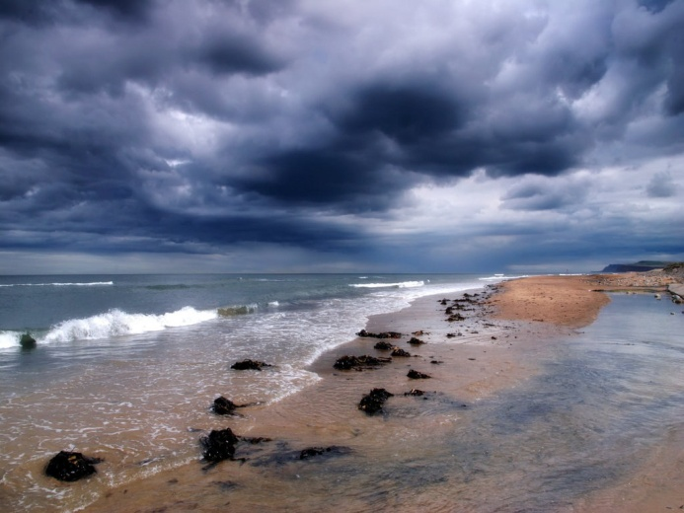
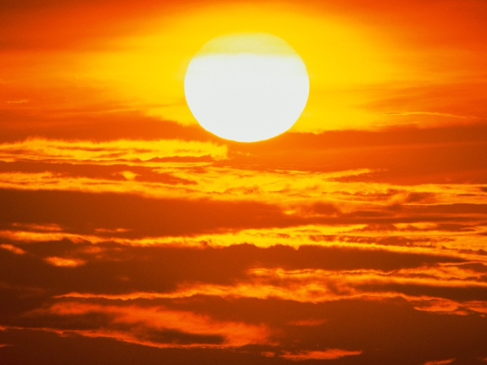
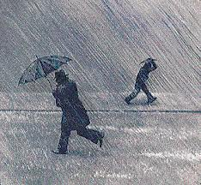
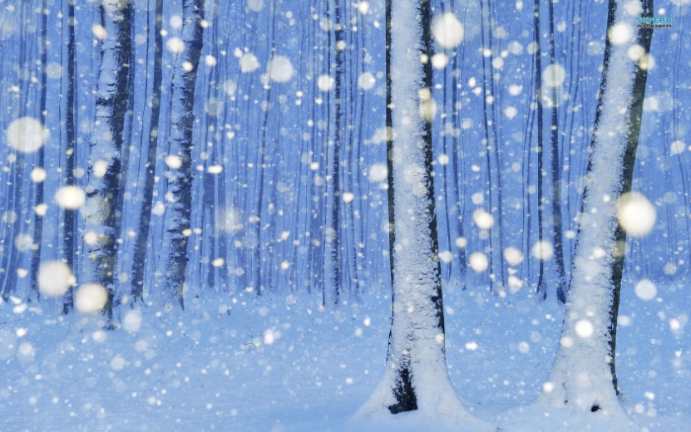
Course 5 Lesson 1 Part B
What´s the weather like?

Slide 2
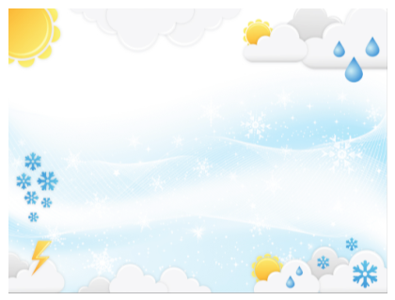
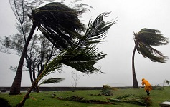

Slide 3
What’s
the
weather
like?

Slide 4

What’s the weather like?
It’s sunny.

Slide 5
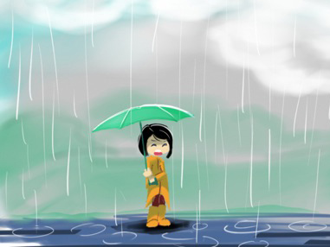

What’s the weather like?
It’s rainy.

Slide 6

What’s the weather like?
It’s snowy.

Slide 7


What’s the weather like?
It’s windy.

Slide 8
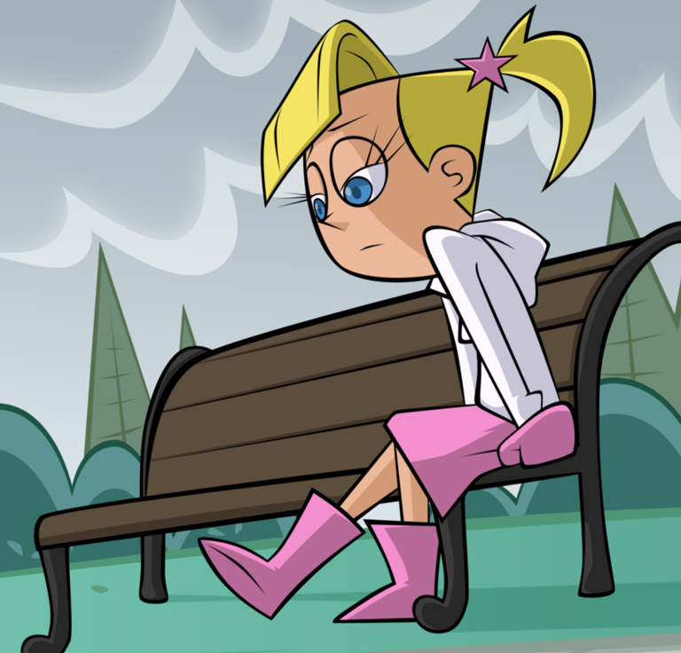
What’s the weather like?
It’s cloudy.

Slide 9
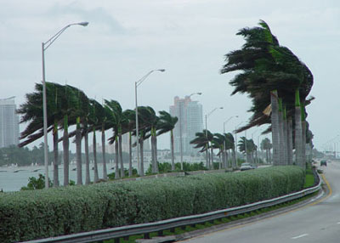
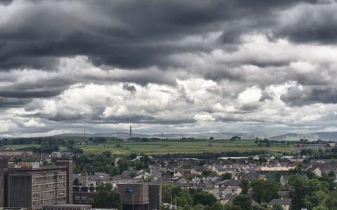
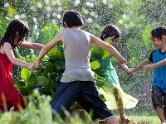
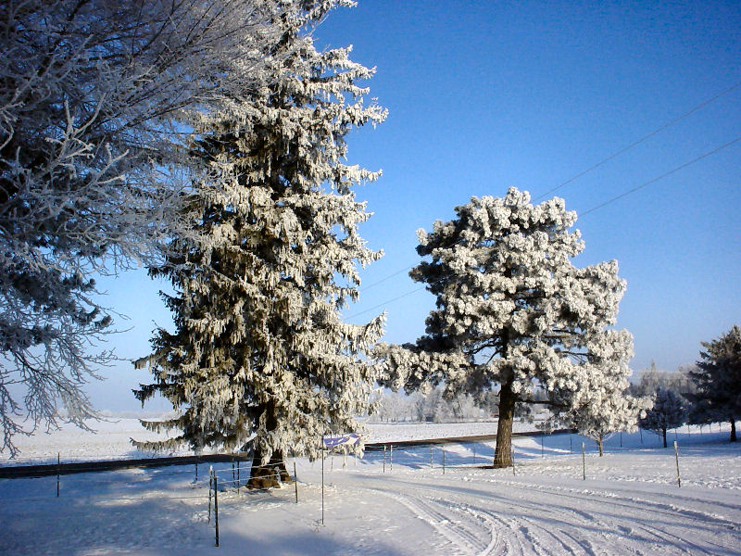
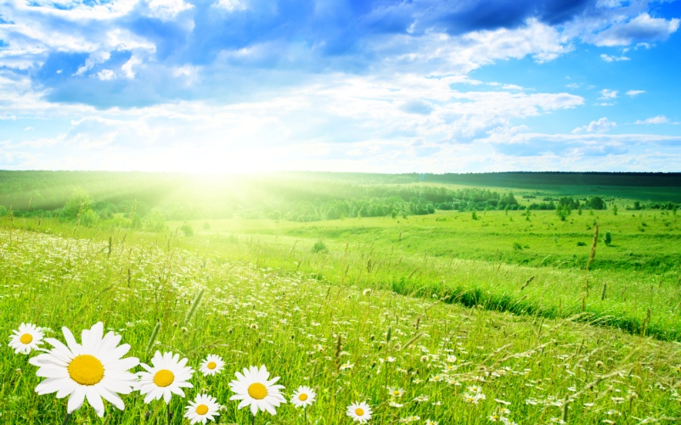
What’s the weather like?

Slide 10
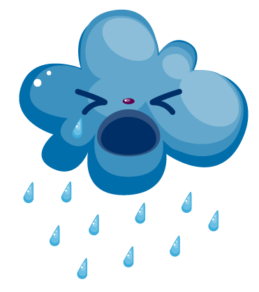
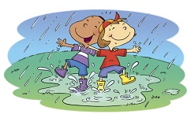
Is it rainy?
Yes, it is.
No, it isn’t.

Slide 11


Is it windy?
Yes, it is.
No, it isn’t.

Slide 12

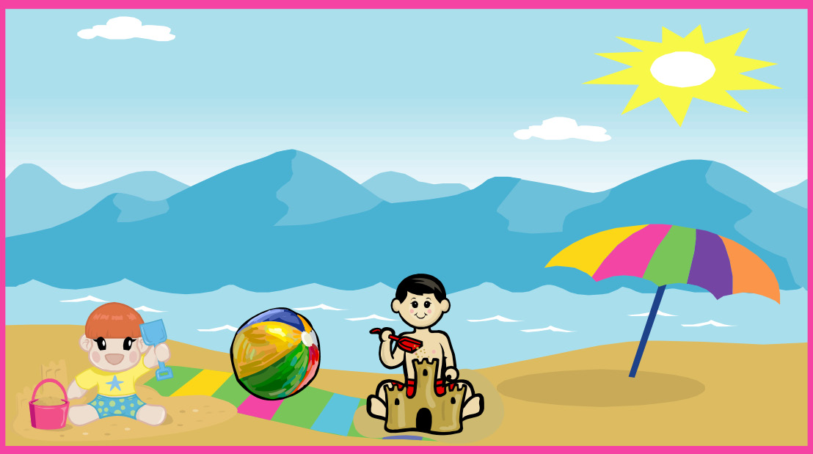
Is it sunny?
Yes, it is.
No, it isn’t.

Slide 13

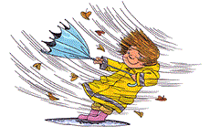
Is it snowy?
Yes, it is.
No, it isn’t.

Slide 14


Is it cloudy?
Yes, it is.
No, it isn’t.

Slide 16
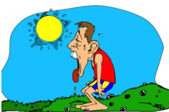
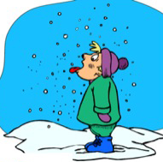
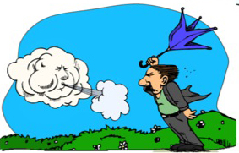

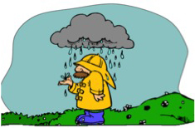
What’s the weather like?
It’s sunny.
It’s snowy.
It’s windy.
It’s rainy.
It’s cloudy.

